Slide 1
Dual Enrollment Orientation
Welcome to

Slide 2
Set up student email
Get an acceptance letter from
dualenrollment@laniertech.edu

Slide 3
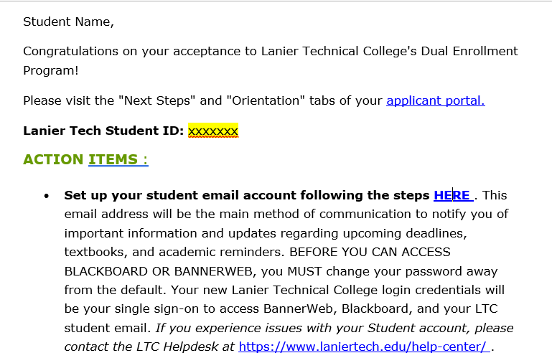

Slide 4
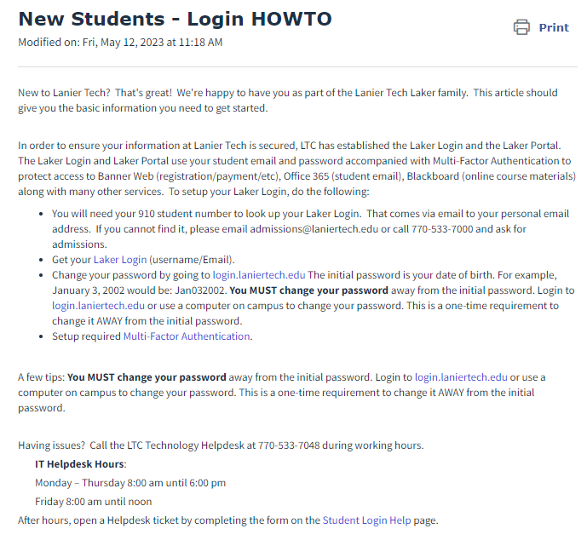

Slide 5
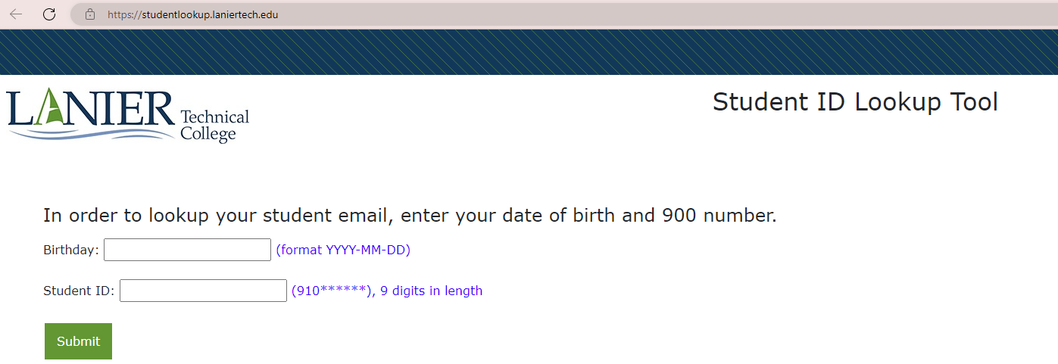

Slide 6
Once you know your Laker Login go to:
https://login.laniertech.edu

Slide 7
Your Laker Login and password will be the same for:
Banner Web Blackboard Email
**Sign out of bannerweb and degreeworks**
clear cache

Slide 8
Multifactor Authentication
MFA
How to in Knowledge Base
https://laniertech.freshdesk.com/support/solutions/articles/44001710121-multi-factor-authentication-setup

Slide 9
MFA

Slide 10
OKTA Verify App
MFA

Slide 11
Printing on Campus
How to in Knowledge Base
https://laniertech.freshdesk.com/support/solutions/folders/44001200057

Slide 12
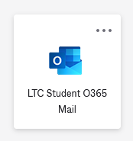
Microsoft Office

Slide 13
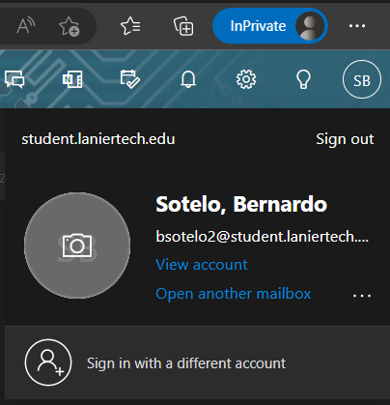
Click on name/picture in top right corner
Last Name, First Name
name@student.laniertech.edu

Slide 14
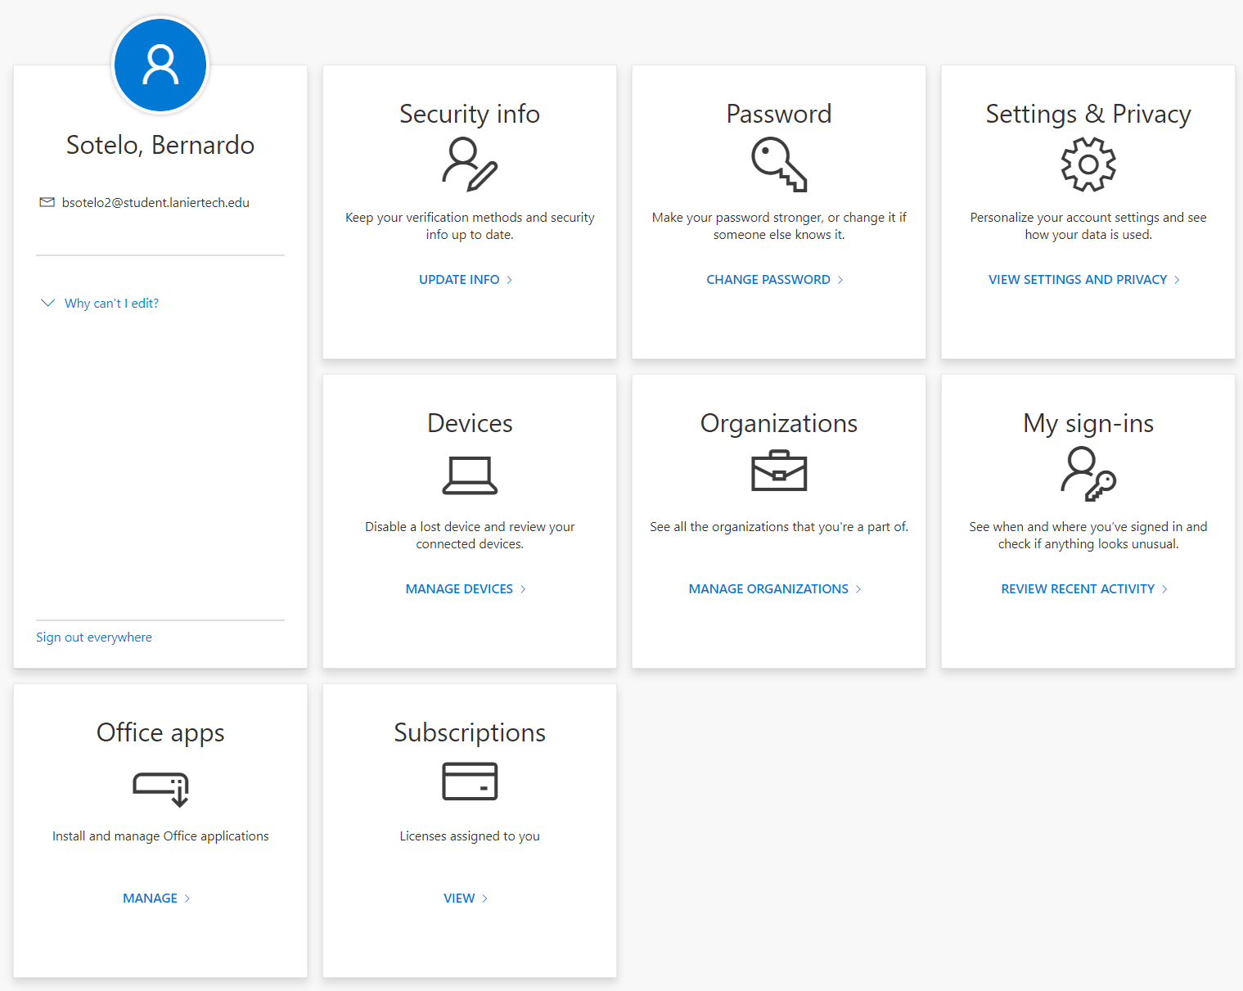
Click either Office apps on left side OR Office apps in middle
Last, First
Student email
OR

Slide 15
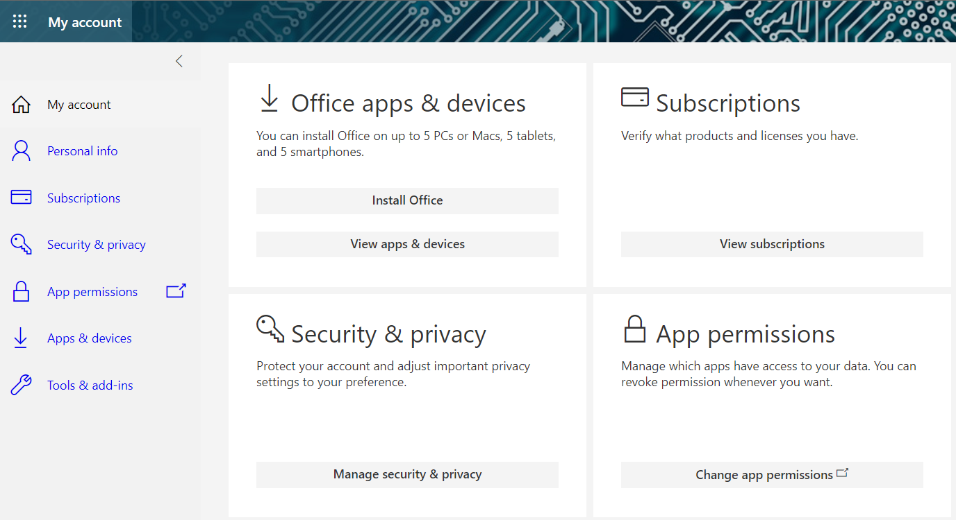

Slide 16
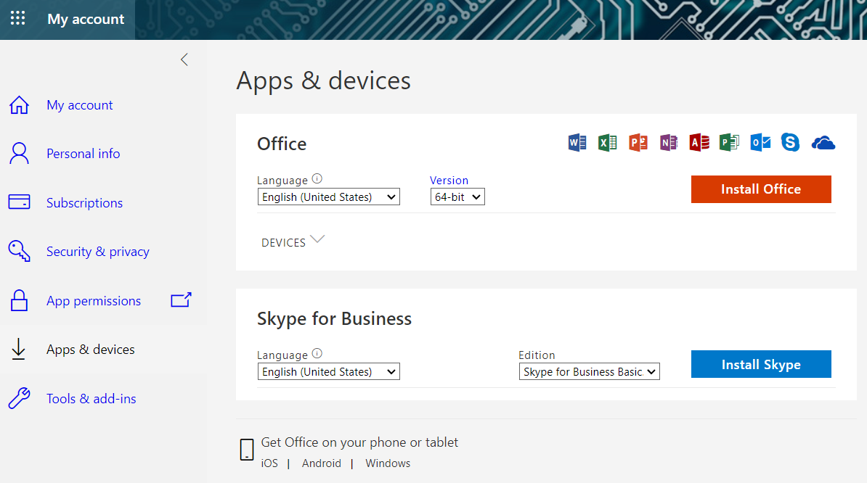

Slide 17
Knowledge Base
https://laniertech.freshdesk.com/support/home

Slide 19
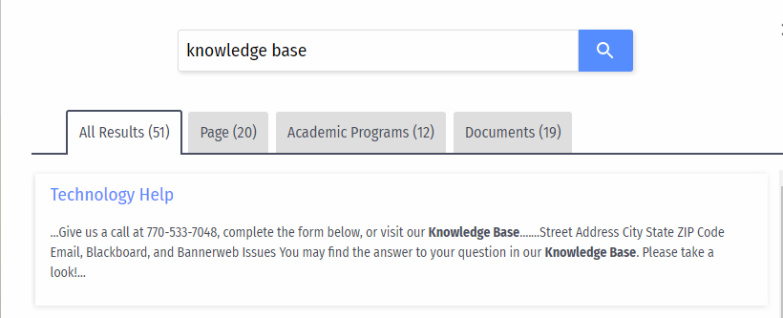

Slide 20
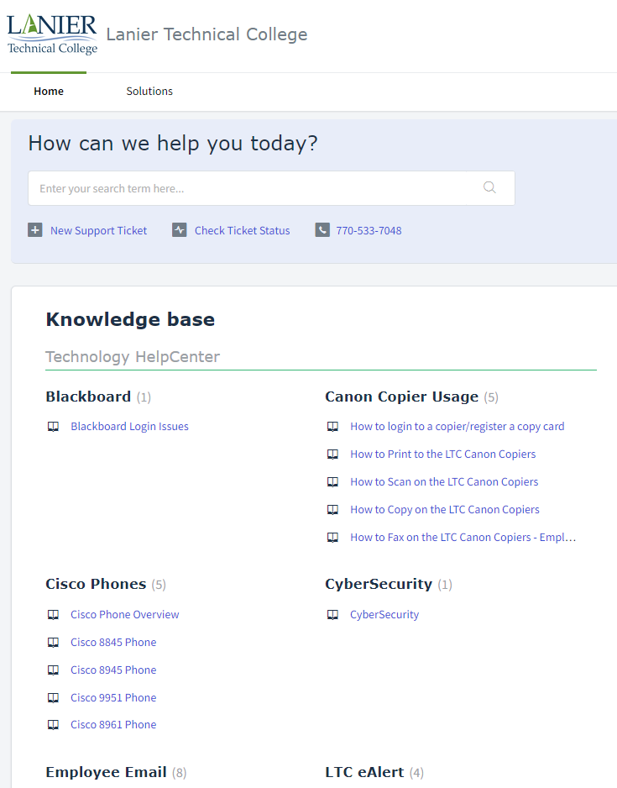

Slide 21
Helpdesk Ticket
https://www.laniertech.edu/help-center/student-login-help/
770-533-7048
Support stations on site

